Slide 2
Advances in Threat and Risk Modeling
Gerald Beuchelt
Cory Casanave

Slide 3
Problem Space
There is a critical need to understand and mitigate threats and risks
Landscape of threats is changing
Multiple attack vectors, cyber and other
Advanced threats utilize multiple vulnerabilities
No comprehensive consistent semantic framework
Existing systems (such as corporate GRC solutions) allow insular treatment of threat/risk relationships
Comprehensive system would allow system-of-systems interoperability (private/private, public/private)

Slide 4
We have critical needs for analytics and information sharing
Cyber
Crime
Terrorism
Critical Infrastructure
Natural
Disasters
Sharing & Analytics
Sharing & Analytics
Sharing & Analytics
Sharing & Analytics
Sharing & Analytics
Threat and risk
Identification, assessment, mitigation, situational awareness
Risks and threats from threat actors and natural sources cross domains
Yet the information sharing and analytics capabilities are stove piped

Slide 5
The Opportunity
Integrated threat and risk management across
Domains
Cyber, Criminal, Terrorism, Critical Infrastructure, Natural disasters, others…
Products and technologies
Enterprise risk management, cyber tools, disaster planning, etc…
Organizations
Government (Global, National, State, Local, Tribal), Non-governmental organizations, Commercial
Leading to
Shared awareness of threats and risks
Federated information analytics (including “big data”)
Improved mitigation of threats and risk
Situational awareness in real time
Ability to respond and recover

Slide 6
The Challenge
There are dozens of standards, exchange schema and technologies for each domain
Each uses different terminology, structure and schema to represent the same or overlapping concepts
These only work together inside of proprietary products. No one product could ever cover the entire scope
Organizations with different or multiple products can’t integrate
There is even less capability across domains
Threat actors and natural disasters don’t respect our stovepipes, they exploit them
Impact: Our capacity for coordinated mitigation and response is severely compromised

Slide 7
Everything has Cyber
Cyber has introduced a critical new need for federation and coordination
Many criminal and terrorist threats have a cyber component
All response capabilities have a Cyber component
We can’t consider Cyber as separate

Slide 8
Everything has “Real World” Consequences
As critical as Cyber is, it is how it impacts our physical world that is critical
Attacks can contain coordinated physical and cyber components
Incidents may have criminal and legal consequences
Cyber and physical need to be understood together

Slide 9
The myth of separate domains
While we like to compartmentalize for efficiency and management
There is no real separation between these domains
Concerns, processes and information cross all boundaries
Our protective forces must be aware of and be able to respond across any “domain”
Become Federated, integrated and coordinated

Slide 10
The 1-1 Anti-Pattern
Faced with a tactical need to bridge any two data structures or systems, it is tempting to manually develop a bridge between those specific structures and technologies. This is a 1..1 mapping.
However, when the problem is considered as an interrelated system of systems, 1..1 mappings between all endpoints is not scalable
There are to many – hundreds to thousands of point-point mappings would be required (an N² problem)
The cost and time to execute is phenomenal
Emergency integration of a new schema is impractical
Different interpretations in each mapping make the end result error prone and unreliable
As schema change or are used differently the set of mappings is not maintainable
Introduction of new technologies becomes impractical – stifling improvements

Slide 11
Primary classes of use cases
Transformation from one information sharing data format to another
Example: NIEM to a CAP Alert
Analytics of information federated from multiple sources
Example: Fusion center “connects the dots” between a stolen laptop (from NIEM) and a cyber incident (From STIX)

Slide 12
What we need is an integrating framework
Cyber
Crime
Terrorism
Critical Infrastructure
Natural
Disasters
Integrating Framework for Threats and Risks
Sharing & Analytics
Sharing & Analytics
Sharing & Analytics
Sharing & Analytics
Sharing & Analytics
An integrating framework that helps us deal with all aspects of a risk or incident
A federation of risk and threat information sharing and analytics capabilities

Slide 13
OMG Standards Process

Slide 14
Recent Developments
Cyber threat models and protocols are maturing
STIX/TAXII used for indicator of compromise (IOC) sharing and some limited modeling adjacent to the cyber domain
Other initiatives (e.g. IODef, Yara, Snort, etc.) are getting beyond their traditional boundaries
Other domains need better shared situational awareness
Emergency management (corporate and governmental)
Software development processes
Interactions with law enforcement

Slide 15
OMG Process
The operational risk/threat RFP has been issued by the Object Management Group
http://www.omg.org/cgi-bin/doc.cgi?sysa/2014-6-17
While there may be multiple submissions to an RFP, the submission team is currently unified and has a working site
https://github.com/omg-threat-modeling/phase1/
The submission team is open and invites collaborators
The final submission is due August 2015 but substantial assets will be developed sooner

Slide 16
Precepts
The purpose/organizational/technology specific schema will not (should not) go away
A “one size fits all” solution will not work
There will be no one technology
There will be no one terminology or language
There will be no one data structure for threats and risks
Our focus is federation
Understanding the concepts behind the schema
Mapping them to/through a common conceptual model
Enabling interoperability by bridging between the specific schema
Supporting integration and coordination of mitigation and response capabilities

Slide 17
Scope
The RFP calls for a conceptual model for operational threats and risks that unifies the semantics of and can provide a bridge across multiple threat and risk schema and interfaces. The conceptual model will be informed by high-level concepts as defined by the Cyber domain, existing NIEM domains and other applicable domains, but is not specific to those domains. This will enable combined Cyber, physical, criminal and natural threats and risks to be federated, understood and responded to effectively.
Out of scope for this RFP is non-operational business relevant risk such as marketplace risk, credit risk, legal risk, project management risk, etc.
The conceptual model will have an explicit mapping to NIEM and STIX. Other exchange formats, such as CAP may be supported as well.

Slide 18
Conceptual Model Requirements
Submissions to the RFP shall define modular UML conceptual models to specify the concepts required to represent information about operational threats and risks.
The conceptual model shall capture the intended meaning of operational threat and risk related concepts such that it may be used as a reference for the use of those concepts in specific exchanges and data stores.
The conceptual model shall not assume any particular technology, domain, representation, structure of information or schema. It shall be a model of the concepts representing real-world entities, not of a specific data representation.

Slide 19
Typical Threat/Risk Concepts To Define
Operational Threat
Operational Risk
Asset
Campaign
Cause
Effect
Exploit target
Goal
Hazard
Impact
Incident
Indicator
Likelihood
Mitigation
Observable
Observation
Observation Metadata
Procedures
Risk
Safeguard
Severity
Strategy
Tactics
Techniques
Threat
Threat actor
Threat source
Undesired event
Note: List not exhaustive.

Slide 20
Clarifying “Operational”
Operational Threat: Operational threats involve specific incidents or groups of incidents that cause unwanted loss or harm to people or important assets or groups of assets. These incidents may be caused by threat actors, accidents or natural phenomenon. Examples include terrorist attacks , hurricanes or an electrical grid failure.
Operational Risk: Operational risks are situations having a negative impact on an organization or company due to uncertainties related to possible breakdowns in a system or its environment via supply chain, injury to a person or failure of a process resulting from intentional/malicious as well as unintentional/natural operational threats. One of the main impacts of operational risks is inability to conduct operations as planned.

Slide 21
Classes of Threat/Risks in scope
Cyber/information and communication systems and assets
Physical systems and assets, including embedded and manufacturing
Electromagnetic spectrum assets (E.g. interference with wireless systems or radio)
Industrial control systems

Slide 22
Scope Diagram
Wide & shallow conceptual model generically covering threats and risks
Other risks (Out of scope)
Operational Threat & Risk Concepts
High level Cyber-threat/risk concepts
Law Enforcement / Emergency Management Concepts
Physical. Spectrum, facilities,
Probabilities, Forensic, Chemical, Biological, Medical, Nuclear, Military and Intelligence threats concepts
STIX/TAXII/Cybox
IODEF
SACM
ISO
NIST
Others…
NIEM Threat/Risk Representation
Other Risks
Systemic Risk
Credit Risk
Market Risk
Pension Risk
Reputation Risk
Liquidity Risk
Legal Risk
Project Management Risk
Legend
Normative
(Formal Specification)
NIEM Exchanges
EDXL / CAP
Others…
Other Inputs
In Scope with Limited Detail
Informative

Slide 23
Submission Team Progress
A team has formed and has resources from both industry and government sources with a collaboration site, regular meetings and email list
UML models of several informative models have been produced
STIX, NIEM, CAP, ISO 072-2009, Business Motivation
Foundational conceptual model has been developed
Mechanisms for UML based mapping are in prototype
Mappings between the conceptual model are started for
STIX
NIEM
Outreach campaign initiated (industry conferences, vendors, standards organizations and government agencies)

Slide 24
Methodology

Slide 25
Approach
Highlight O(N) vs. O(N^2)
Construct a conceptual model informed by existing schema, research and best practices
This conceptual model is independent of specific data structures, technologies and terminologies
Define mapping models between the conceptual model and purpose/organizational schema
Make both models sufficiently precise that they can drive automated bridging between any mapped schema
Cyber
Terrorism
Cyber
Cyber
Cyber
Disasters
Map/Bridge
Map/Bridge
Map/Bridge
Conceptual Model
Map/Bridge
Map/Bridge
Criminal
Cyber
Criminal
Infrastructure

Slide 26
Relationship to DIKW Model
Based on C. Zins definitions, DOI: 10.1002/asi.20508
Wisdom (Insight)
Knowledge
Data
Information
Physical Models, schemas
Logical models
Conceptual Models
Objects, instances
Predictive
Capabilities
Descriptive
Capabilities

Slide 27
Core Concept: Comprehending Planned and Unplanned Threats
“All hazards” include man-made and natural disasters/system failures
There is not always an actor involved (e.g. hurricane, system malfunction)
Threat actors are not not only actors
Non-malicious actors may constitute significant threat (e.g. spear-phishing victim, power plant operator)
Defenders (e.g. system admins, law enforcement, medical staff) are also actors with defensive plans
Victims are actors as well

Slide 28

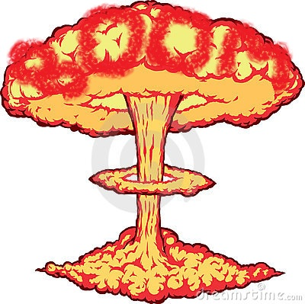


Intent
Threat Actor
Plan
Capability
Act
Potential Effect
Real World Effect
Vulnerability
Risk
Threat
Incident
Consequence
Impact on Objectives
Stakeholder
Potential Event
Actual Event
Natural event or System failure

Slide 29
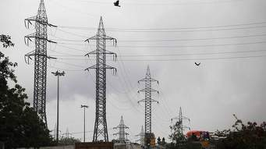

Core Concept: Attacker/Defender Symmetry
Attack perspective:
Defender: Attackers/hazards are threats
Attacker: Targets are opportunities
Defense perspective:
Attacker: Successful defense is a threat to the intentions/objectives
Defender: Maintaining effective defensive posture is an opportunity
Threat vs. Opportunity is in the eye of the emoticon – it is not sufficent to create static classifications
Opportunity!
Capability to disrupt the power grid
Threat!
Notes:
One mans risk is another mans opportunity
The same risk/threat/incident needs to be understood from very different perspectives
Classifying something as a risk/threat/incident or mitigation only makes sense with respect to how it impacts the objectives of some stakeholder. E.g “a risk of damage to the U.S. power grid impacting millions”.
The conceptual model supports this separation while mapping to structures that assume a particular perspective.

Slide 30
Core Concept: Actor Capabilities
Limiting actors to a static or single role in a specific scenarios is not helpful
Defensive actors may use offensive actions and plans to achieve defense objectives
Attackers may use defensive actions for ensuring OPSEC for the plan
Bystanders may support defensive or offensive plans or actions
Capabilities are a better way to characterize actors
Capabilities may include offensive, defensive, and other abilities
Actors can leverage capabilities in executing plans

Slide 31
Example Scenario

Slide 32
Example Scenario: Coordinated Power Grid Attack
Attack
Laptop with access credentials is stolen
Grid industrial control system is compromised in Cyber attack
Physical attack on substation disrupts power
Compromised system cascades failure
Physical infrastructure damaged
Potential Mitigations
Law enforcement recovers laptop
Compromise is recognized by Cyber defense, system is hardened
Law enforcement notified and arrests attackers
Preparation is identified and defense forces put in place
Real-time notification of systems going down initiates manual shutdown

Slide 33


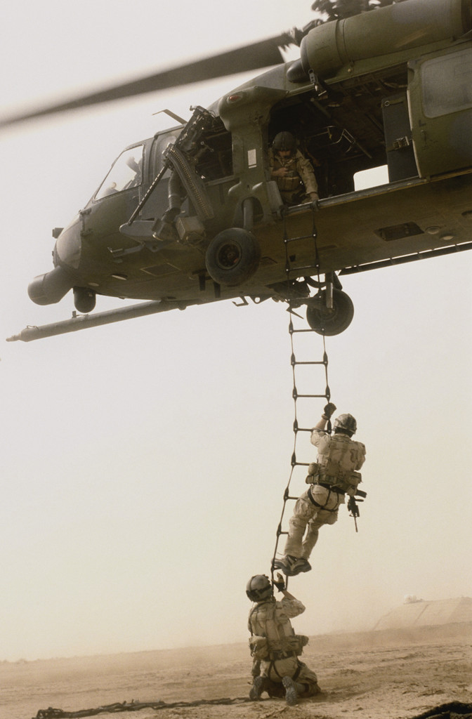


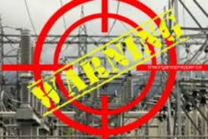
Potential Information Flows
Suspicious Activity Report
NIEM
Incident
Arrest Report
STIX Incident
Tactical Response Unit
Fusion Center
Intelligence
Report
IT System Hardening
Manual Shutdown
Public CAP Warning

Slide 34
Bridging Experience Domains with common concepts
Common Concepts
What is the current context
What is happening
What is venerable
What is the impact
Who is impacted
Who is doing this
What can we do
What are we doing
Who should know
How they are used
Data elements in multiple schema are mapped to the underlying concepts
Bridge technologies enable cross-domain, cross-organizational and cross-technology information sharing

Slide 35
Example Use Case: Large Company
Company with multiple datacenters, office facilities, international business activity
Large number of deployed security systems, sensors
Firewalls, IDS/IPS, SIEM, monitoring systems, notification/alerting, etc.
Uses FW/Snort rules, STIX/TAXII, IODef, alarms for fire and intrusions, etc.
Physical and information security staff, some 24/7
Interoperable (but not uniform) threat monitoring and assessment

Slide 36
Model Details
Examples of specific risk/threat concepts – intended to show how the conceptual model is being produced

Slide 37
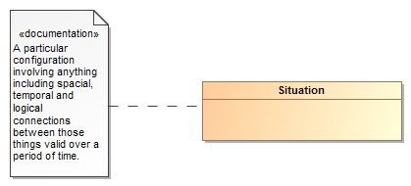
Threats and Risks of What?
A threat or risk is with respect to some undesirable situation
What is a situation?
We define a situation as a configuration of things…
People places, things, events, occurrences and the connections between them.
Some situations are consequences of others
Situations provide a link between different kinds and phases of threats & risks

Slide 38
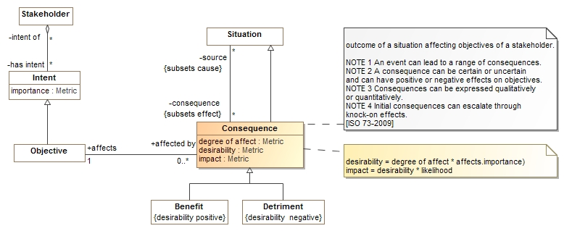
Consequences
Situations may have consequences (an effect of the situation)
Consequence can be positive or negative: benefits or detriments, respectively
Consequences affect the objectives of stakeholders
This leads to the desirability of the consequence (positive or negative)
Desirability * likelihood provide the impact (→risk metric for detriments)

Slide 39
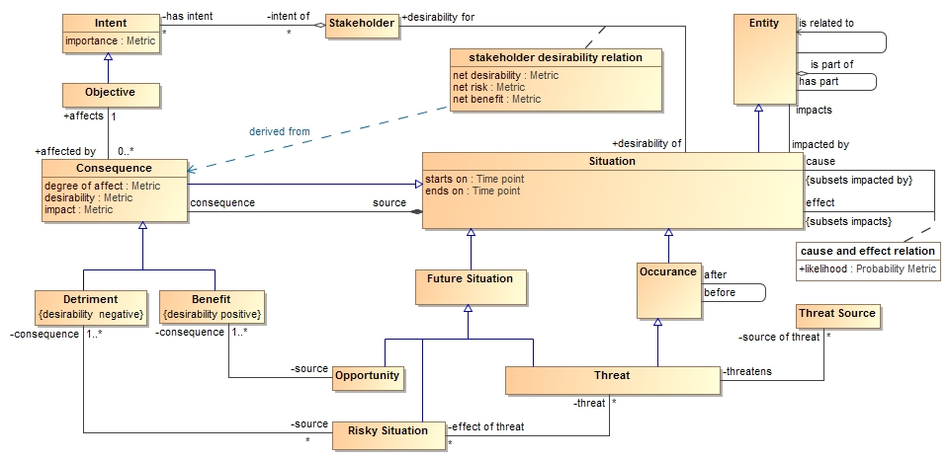
Core Risk/Threat Concepts

Slide 40
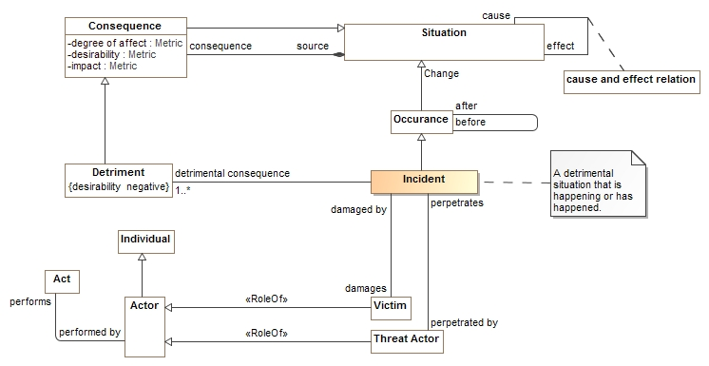
Incidents

Slide 41
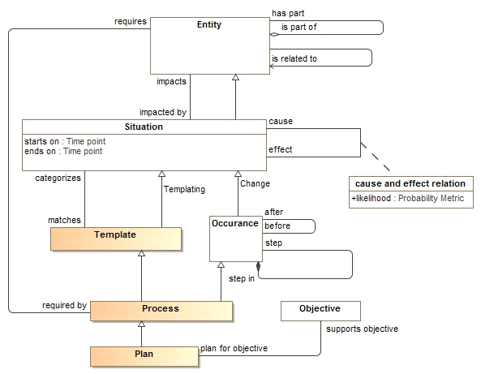
Processes and plans

Slide 42
Mapping example
Transformation from one information sharing data format (STIX) to another (NIEM)

Slide 43
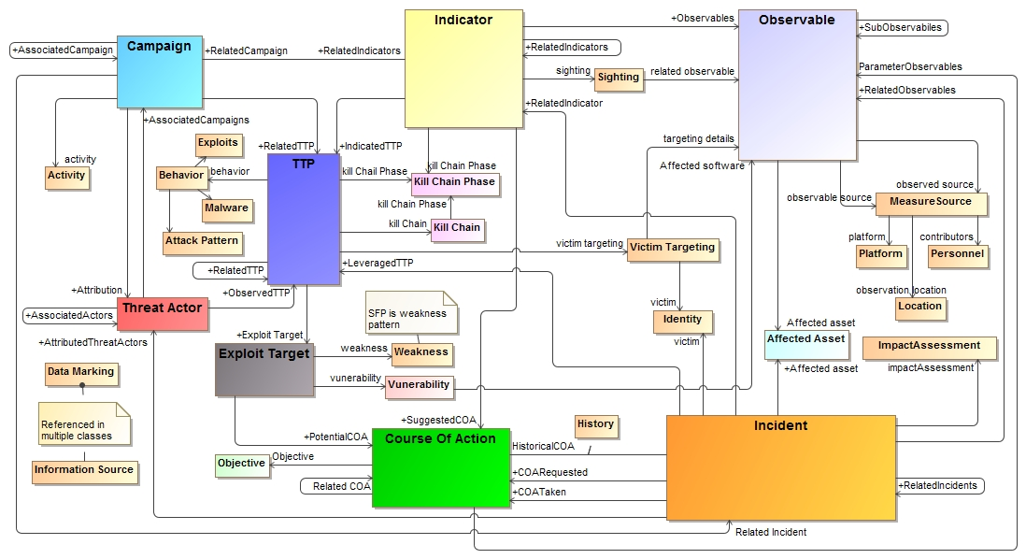
STIX (High Level) in UML

Slide 44
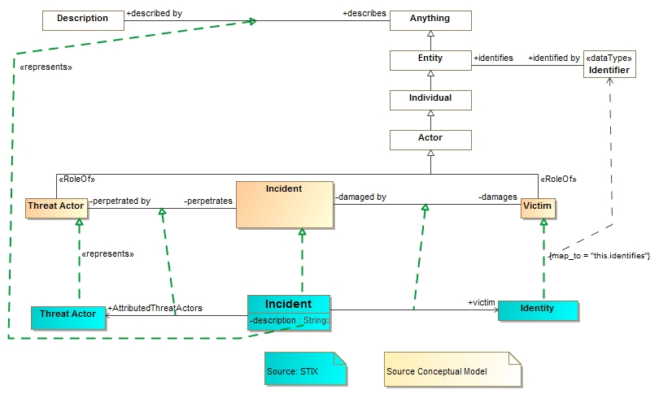
STIX Mapping fragment
Note: Complete mapping rules are more complex

Slide 45
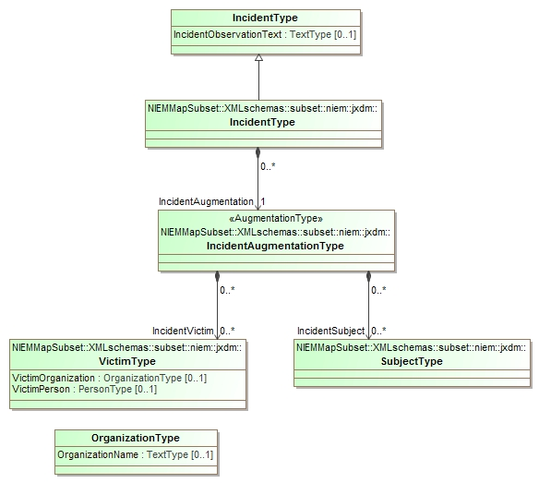
NIEM Subset of interest
Multiple classes representing an incident due to the way NIEM segments domains

Slide 46
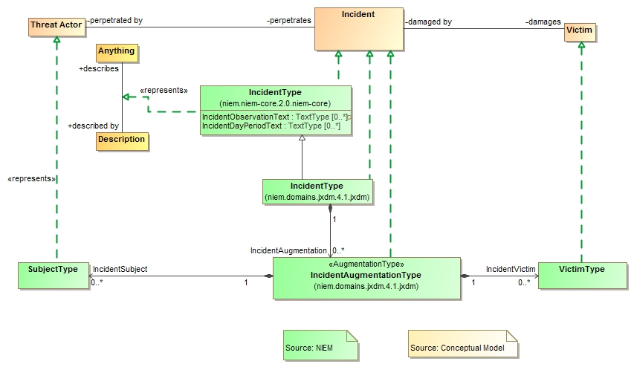
NIEM Mapping Fragment

Slide 47
Example STIX data
<stix:Incident id="example:incident-fd56fb34-af59-47b3-95cf-7baaaa53fe93" timestamp="2014-08-28T16:42:52.859547+00:00" xsi:type='incident:IncidentType' version="1.1.1">
<incident:Title>Breach of Canary Corp</incident:Title>
<incident:Time>
<incident:Incident_Discovery precision="second">2013-01-13T00:00:00</incident:Incident_Discovery>
</incident:Time>
<incident:Description>Intrusion into enterprise network</incident:Description>
<incident:Reporter>
<stixCommon:Description>The person who reported it</stixCommon:Description>
<stixCommon:Identity id="example:Identity-5db269cf-e603-4df9-ae8c-51ff295abfaa">
<stixCommon:Name>Sample Investigations, LLC</stixCommon:Name>
</stixCommon:Identity>
<stixCommon:Time>
<cyboxCommon:Produced_Time>2014-03-11T00:00:00</cyboxCommon:Produced_Time>
</stixCommon:Time>
</incident:Reporter>
<incident:Victim id="example:Identity-c85082f3-bc04-43c8-a000-e0c1d0f2c045">
<stixCommon:Name>Canary Corp</stixCommon:Name>
</incident:Victim>
<incident:Impact_Assessment>
<incident:Effects>
<incident:Effect xsi:type="stixVocabs:IncidentEffectVocab-1.0">Financial Loss</incident:Effect>
</incident:Effects>
</incident:Impact_Assessment>
<incident:Confidence timestamp="2014-08-28T16:42:52.859570+00:00">
<stixCommon:Value xsi:type="stixVocabs:HighMediumLowVocab-1.0">High</stixCommon:Value>
</incident:Confidence>
</stix:Incident>

Slide 48
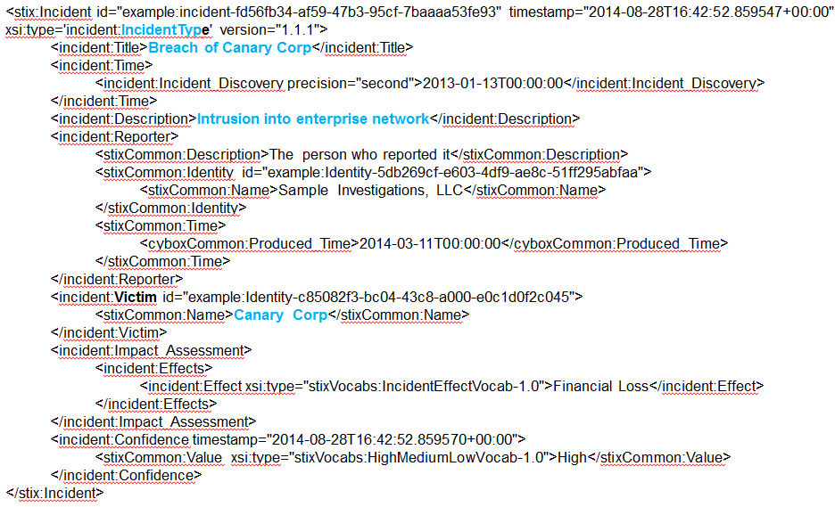
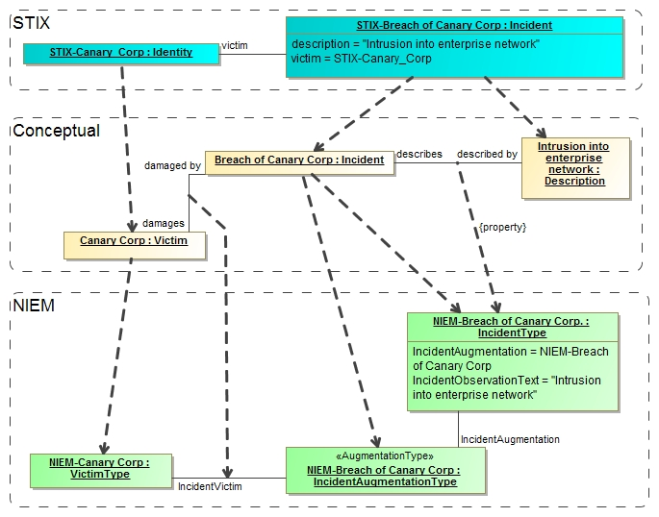
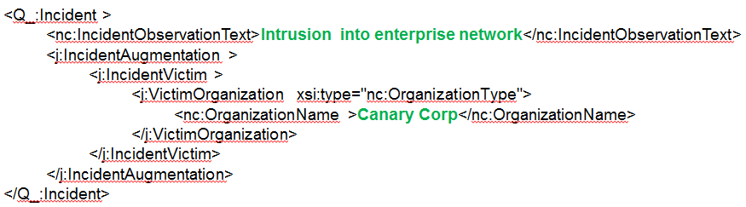
Notional Model Mapping Instances
STIX Data
Note: Conceptual instances are “virtual”, no actual instances are necessarily created.
NIEM Data

Slide 49
Derived NIEM Data
<Q_:Incident >
<nc:IncidentObservationText>Intrusion into enterprise network</nc:IncidentObservationText>
<j:IncidentAugmentation >
<j:IncidentVictim >
<j:VictimOrganization xsi:type="nc:OrganizationType">
<nc:OrganizationName>Canary Corp</nc:OrganizationName>
</j:VictimOrganization>
</j:IncidentVictim>
</j:IncidentAugmentation>
</Q_:Incident>
Note that only elements of interest that have a correspondence between STIX and NIEM are mapped. However, this kind of summary may be what is needed by, for example, law enforcement.

Slide 50
Outlook

Slide 51
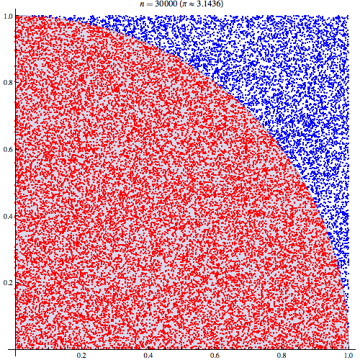
Additional Applications
People
Technology
Governance
Risk
Compliance
Operations
Enterprise Risk Modeling
Cross-domain accounting for threats, vulnerabilities, and risk
Tighter integration with public information sources
Modeling for Response Strategies
Parameterization of threat and risk landscape
Monte-Carlo simulation and response testing
Real time situation awareness
Analytics
"Pi 30K" by CaitlinJo - Own workThis mathematical image was created with Mathematica. Licensed under Creative Commons Attribution 3.0 via Wikimedia Commons

Slide 52
Conclusions
Current logical models are application domain specific or domain centric
Focus on emergency management, cyber/INFOSEC, law enforcement, etc.
Interoperability between different systems is hard and manual
No comprehensive threat pictures that includes an “all-hazards” view
Conceptual model can add this by providing semantic glue to allow effective mapping
Call to Action: Engage with “Team Threat & Risk”

Slide 53
Dumpster/Backup

Slide 54
PT XML (notional)
Cap XML
Physical Threat Model
CAP (Model)
IODef (model)
Snort (model)
IODef (protocol)
STIX PIM
Snort rules
STIX XML
STIX JSON

Slide 55
PT XML (notional)
Cap XML
Physical Threat Model
CAP (Model)
IODef (model)
Snort (model)
IODef (protocol)
STIX PIM
Snort rules
STIX XML
‘Semantic Glue’
(i.e. Conceptual Threat Model)
STIX JSON

Slide 56
Clarifying “Operational”
Operational Threat: Operational threats involve specific incidents or groups of incidents that cause unwanted loss or harm to people or important assets or groups of assets. These incidents may be caused by threat actors, accidents or natural phenomenon. Examples include terrorist attacks , hurricanes or an electrical grid failure.
Operational Risk: Operational risks are situations having a negative impact on an organization or company due to uncertainties related to possible breakdowns in a system or its environment via supply chain, injury to a person or failure of a process resulting from intentional/malicious as well as unintentional/natural operational threats. One of the main impacts of operational risks is inability to conduct operations as planned.

Slide 57
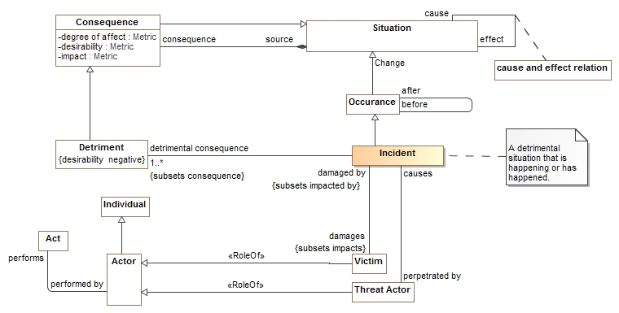
Example Conceptual Model Fragment

Slide 58
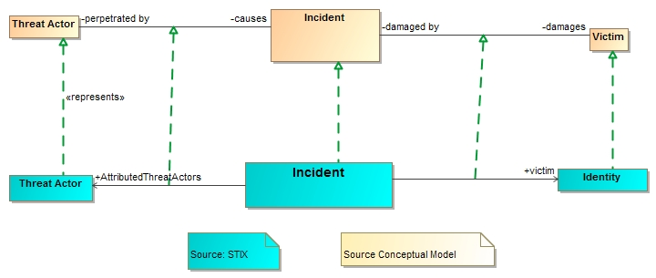
Example Mapping Fragment

Slide 59
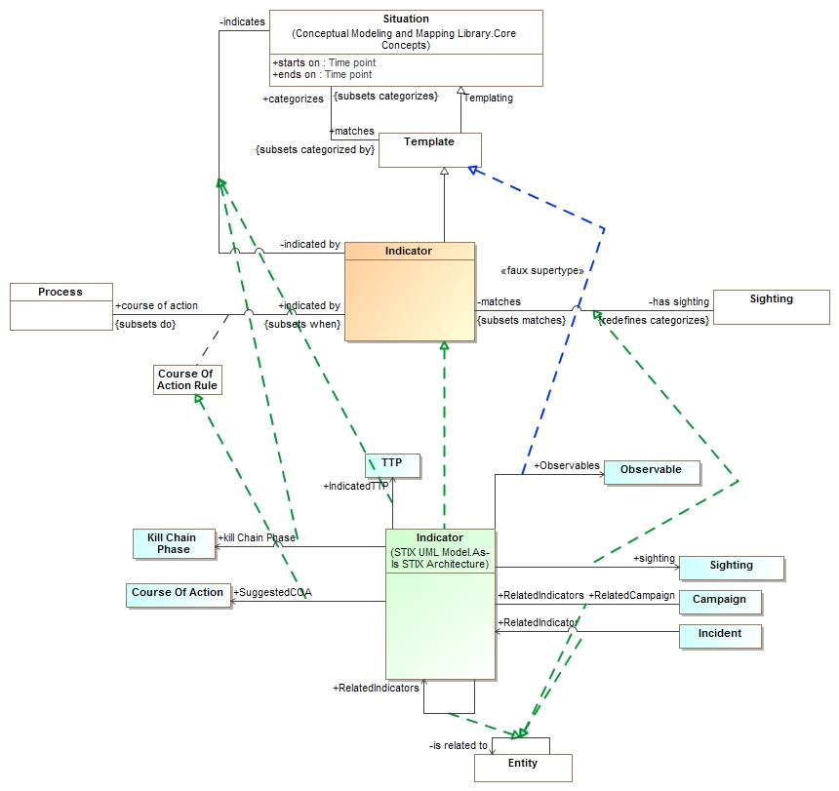
Indicator Mapping
STIX to Conceptual Model

Slide 60
Example Scenario: Corporate SAR & Incident Management
Indicators of Compromise
Email/RSS
Datacenter IDS
STIX/IODef
IDS
Inteligence
Corporate SOC
Log Management
PDF/STIX
Syslog
Email
NIEM
Customer
ThreatConnect
IC3

Slide 61
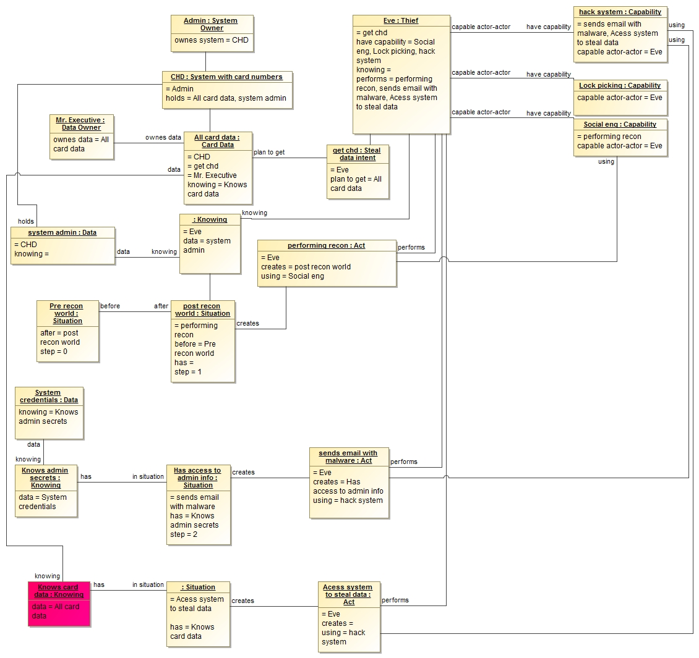
Walkthrough: Instance Model for Credit Card Theft

Slide 62
Walkthrough: Step 1 - Reconnaisance

Slide 63
Walkthrough: Step 2 – Post Recon

Slide 64
Walkthrough: Step 3 – Phishing

Slide 65
Walkthrough: Step 4 - Theft

Slide 66
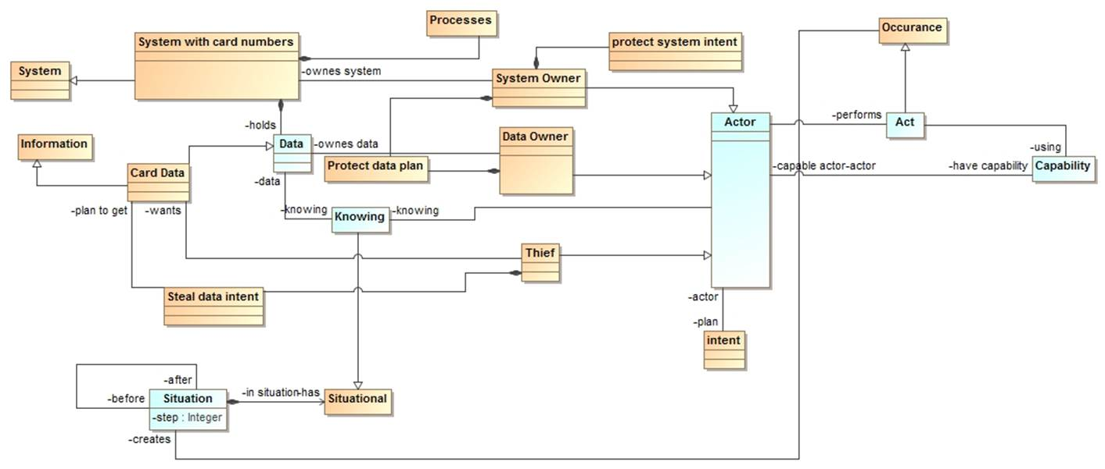
Corresponding Class Model

